Slide 1

Delayed Differential Equations
Chris Adrowski, Olivia Davis, Tony Martin

Slide 2
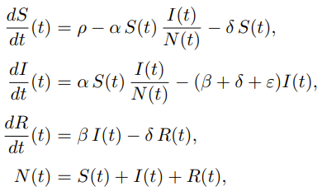
Epidemiology models
Standard SIR Adaptation
Accounts for birth and death rates
Single-time infection

Slide 3
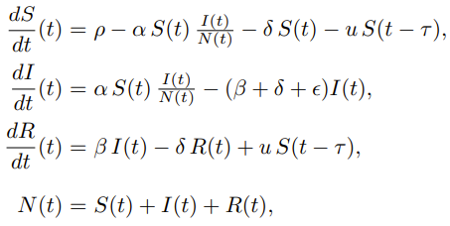

Epidemiology models
Two different types of delayed differential equation models
Vaccines being introduced with varying rates of vaccination
τ is the lag between being vaccinated and being immune
Disease has a fixed life span before a person recovers
τ is the lifespan of the disease

Slide 4
Epidemiology models
Two different types of delayed differential equation models
Vaccines being introduced with varying rates of vaccination
τ is the lag between being vaccinated and being immune
Disease has a fixed life span before a person recovers
τ is the lifespan of the disease

Slide 5
Epidemiology models
Two different types of delayed differential equation models
Vaccines being introduced with varying rates of vaccination
τ is the lag between being vaccinated and being immune
Disease has a fixed life span before a person recovers
τ is the lifespan of the disease

Slide 7


El Niño and La Niña modeling
Notes:
Looking at models 10.7 and 10.8, basic solvers were implemented to ensure that the ddesd function in matlab could be properly utilized when looking at the El Niño and La Niña modeling. The response predicted for times greater than 0 was created via the models using tau=10

Slide 8
El Niño/La Niña (ContD.)
Notes:
After the modes with constant functions for histories were figured out, the physical El Niño and La Niña data was implemented into our model as the history and a natural spline was used to create a history function that the delayed diff eqn solver could use. This was again done assuming tau=10. After a history was implanted, a new model was used to explore the affects of trig functions in the delayed diff eqn

Slide 9
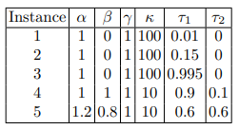

El Niño/La Niña (ContD.)
Notes:
A variety of instances were used with multiple different history functions and the responses varied for the various instances. For instance 1, the line seemed to die down and oscillate slightly above and below 0.

Slide 10
El Niño/La Niña (ContD.)
Notes:
This was different than the response of instance 3 where the oscillations were shifted depending on the history as well as having a response similar to that of a combined wave with multiple frequencies.

Slide 11
El Niño/La Niña (ContD.)
Notes:
Similar to instance 1, the solution for instance 5 settled although the time to settle to the steady state oscillation was significantly longer than that observed in instance 1. This was due to the beta value in Model 10.9 being non-zero. Once the new model was tested, we implemented this model with our data for the history.

Slide 12
El Niño/La Niña (ContD.)
Instance 3
Instance 1
Instance 5
Notes:
Using the histories yielded very similar responses where instance 1 settled quickly, instance 5 settle slower, and instance 3 had multiple frequencies present in the response wave.

Slide 13
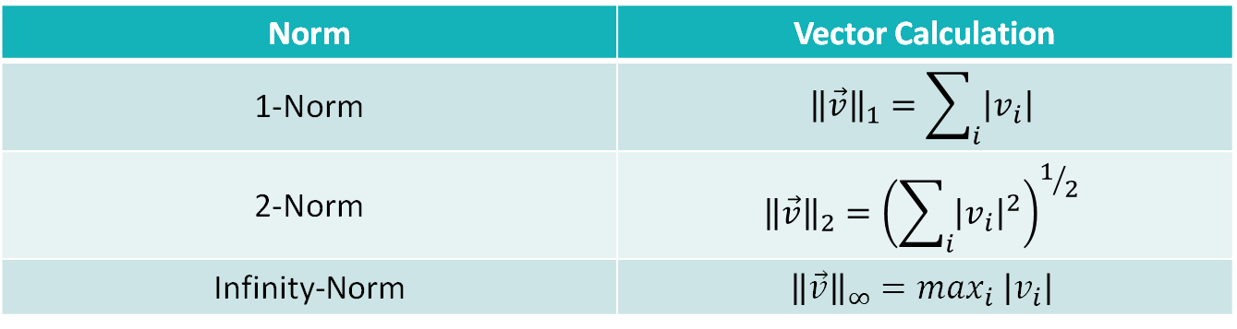
El Niño/La Niña (ContD.)
Optimize α and τ to best fit the historical data
Norm | Vector Calculation
1-Norm | $${\left\|\vec{v}\right\|}_{1}=\sum_{i}{\left|v_{i}\right|}$$
2-Norm | $${\left\|\vec{v}\right\|}_{2}={\left(\sum_{i}{{\left|v_{i}\right|}^{2}}\right)}^{1/2}$$
Infinity-Norm | $${\left\|\vec{v}\right\|}_{∞}=\max_{i} \left|v_{i}\right|$$
Notes:
Expanding on model 10.8 more, we wanted to see if we could optimize the values for alpha and tau such that we could match our response with our known history. To check how “chose” we were, we used the 1-, 2-, and infinity-norms to see how close our solution was. By defining the vector v as the difference between our response and our history at known points, the norms could be calculated and the best value that minimizes the norm documented. The 1-norm is the summation of all of the differences, the 2-norm is the ecludian norm of all of the differences (the root sum squared), and the infinity-norm is the maximum difference. Minimize these different norms should yield different values for the “best” alpha and tau

Slide 14
El Niño/La Niña (ContD.)
Infinity-Norm
1-Norm
α=2.8, τ=0.5
α=1.415, τ=0.9
Notes:
Starting with our history ranging from 1950-1960 and our data to compare being the 10 years following, we found the “best” alpha and tau values to minimize the infinity- and 1-norm. The graphs are very different, as expected yet they both have some oscillation which matches the data sort-of

Slide 15
El Niño/La Niña (ContD.)
2-Norm
1-Norm
α=1.4441, τ=0.8196
α=1.415, τ=0.9
Notes:
In this case, and many other, the 2- and 1-norms had very similar results and plots for the “best” parameter values.

Slide 16
El Niño/La Niña (ContD.)
Infinity-Norm
1-Norm
α=2.6, τ=0.49
α=0.8575, τ=1.6183
Notes:
If we looked at the next decade where our history was from 1960-1970 and our comparison data the next 10 years, once again our infinity- and 1-norm solutions don’t match up. Our 1-norm solution, which also matches our 2-norm solution, does not seem to fit the data well at all whereas the infinity-norm, while it does a poor job at directly matching the data, does somewhat fit the oscillatory nature of the data.

Slide 17
El Niño/La Niña (ContD.)
Infinity-Norm
1-Norm
α=2.8, τ=0.5
α=1.4, τ=0.9
Notes:
After looking at predicting 10 years of data, we tried to predict 20 years to see how good the results would be. For this case, both the responses shown have an oscillatory nature yet, once again, the infinity-norm seems to fit the best. However, when looking 20 years out, something interesting happened.

Slide 18
El Niño/La Niña (ContD.)
2-Norm
1-Norm
α=0.7, τ=1.7
α=1.4, τ=0.9
Notes:
While normally the 1- and 2-norms match relatively closely, looking 20 years out severely changes the “best” parameter values between the 1- and 2-norm responses. The 2-norm in this case looks very odd and does not seem to match the data much at all yet that was found to be the “best” solution. Within all of these tests, the range of initial test parameters was alphas between 0 and 5 and tau values between 0 and 2. Increasing this range to 0 to 15 for both ensured us that we were not simply finding local minima and rather that we were finding global minima such that we found the “best” possible solution to the paraemters.

Slide 19
El Niño/La Niña (ContD.)
Infinity-Norm
1-Norm
α=2.6, τ=0.4
α=0.83, τ=3.91
Notes:
With the new ranges, checking a 20 year span the following responses were created. The infinity-norm did not look good in this version even though the alpha is only 0.2 less than the previous 20 year prediction and the tau is 0.1 less. However, looking at the 1-norm, the “best” tau value found was actually outside our range for the 20 year prediction and the nest tau was found to be nearly 4. Looking at the response, it does not look great and has lost its oscillatory nature that was seen previously. Overall, with all of this data, it seems that the infinity-norm yields the best solutions or at least the closest since minimizing the infinity-norm minimizes the maximum gap between the predicted response and the physical data. Knowing this, the efforts to optimize alpha, tau1, beta, and tau2 in model 10.9 will primarily focus on optimizing the infinity-norm. That optimization has not been completed by our team for that model yet so we cannot say what the optimal parameters are for specifically although we plan on exploring that.

Slide 20

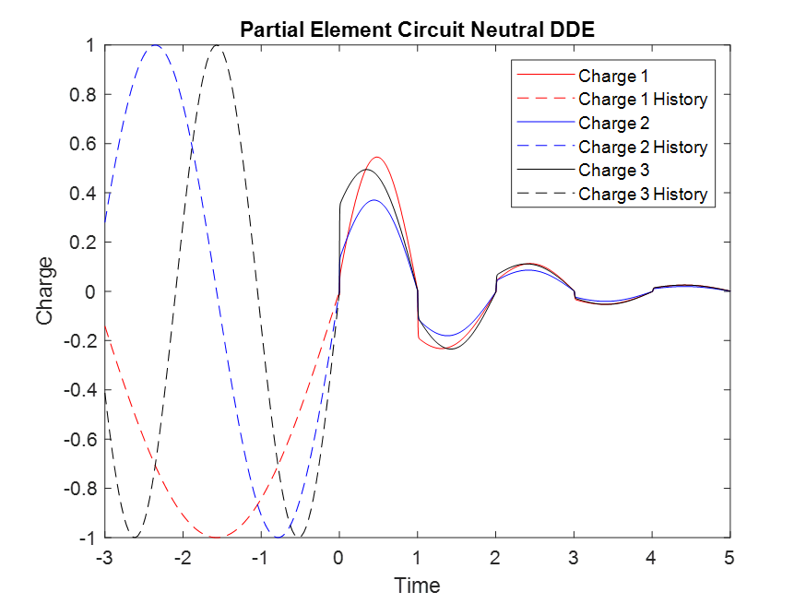
partial element circuits
We modelled a neutral DDE to study partial element circuits (see equation to the right)
We used the following histories:
sin(t) shown in red
sin(2t) shown in blue
sin(3t) shown in black
The delay of the initial figure is 1.

Slide 21
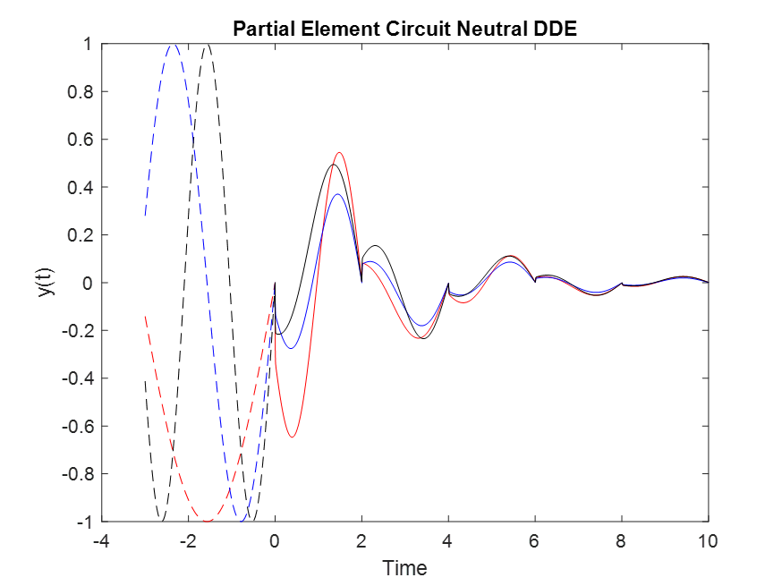
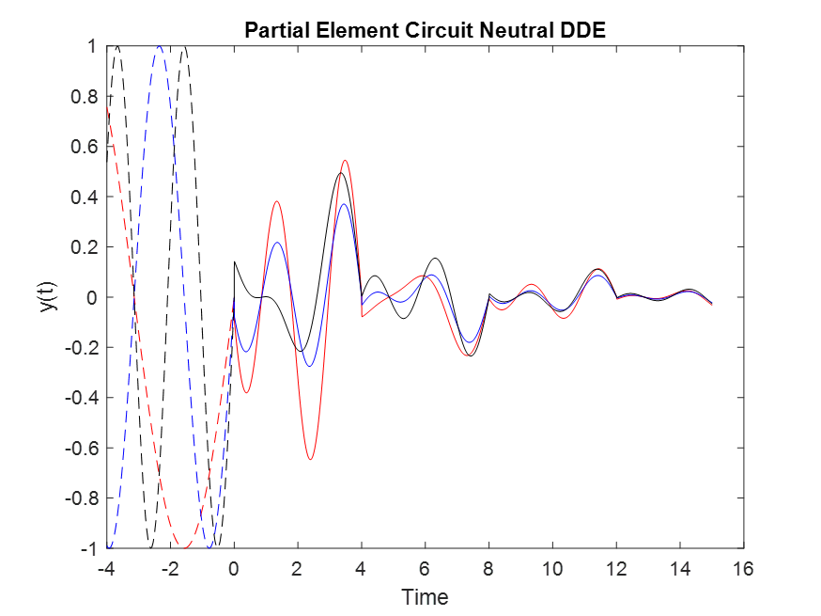
PEEC (Contd.)
We also modelled a lag of 2 and compare it with a lag of 4
The larger lag leads to significant differences in the beginning, but regardless of lag the behavior of all histories begin to match and converge to zero.

Slide 22
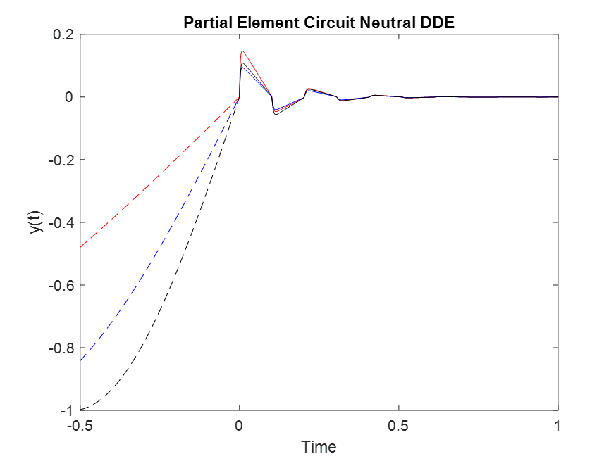
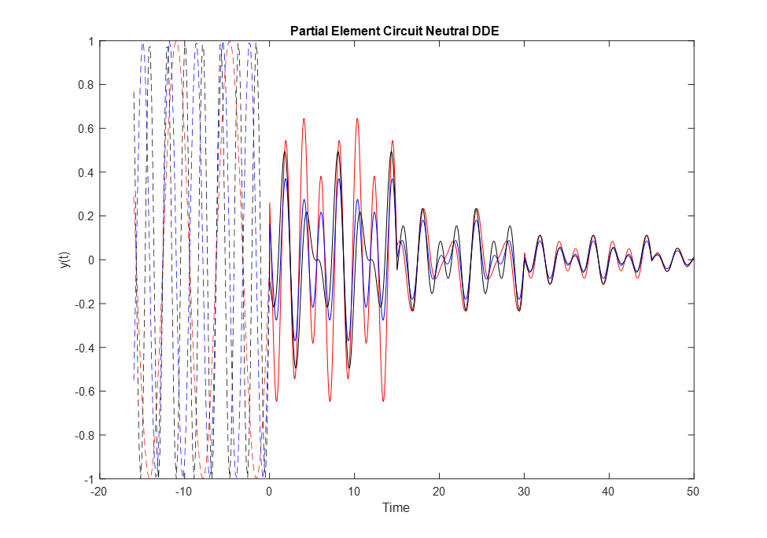
PEEC Extremes
Lag = .1
Lag = 15

